Slide 1
Semantic Textual Similarity
Team KLM
Beeraka Krupa Kiranmai (2021201022)
Padigala Lakshman Sai (2021201069)
Nalluru Maneesh Gupta (2021201041)

Slide 2
Contents
Problem Statement
Example
Dataset, Evaluation Metric
Base Model –1
Base Model –2
Siamese Model with Architecture
CNN Model , Architecture
Hyperparameters
Results

Slide 3
Problem Statement
This project aims to develop methods for assessing the degree of similarity between pairs of sentences using Semantic Textual Similarity (STS) measures. focusing on two specific sub-tasks: monolingual assessment in English-English and Spanish-Spanish, using a Gold Standard scale ranging from 0 to 5.

Slide 4
Example
 | S. No. | Sentence 1 | Sentence 2 | STS Score
English - English | 1 | The bird is bathing in the sink. | Birdie is washing itself in the water basin. | 5.0
 | 2 | They flew out of the nest in groups. | They flew into the nest together. | 2.0
Spanish-Spanish | 1 | El primer sistema Cray-1 fue instalado en el laboratorio nacional de Los Álamos en 1976. | El Cray-1 fue sucedido en 1982 por el Cray X-MP de 800 MFLOPS, la primera computadora multi-proceso. | 2.0
 | 2 | El "rock espacial" ("space rock" en inglés) es un género musical surgido durante la década de los años 1960 como una corriente del rock psicodélico y la música progresiva. | El space rock emergió a finales de los 60 en Reino Unido dentro de la llamada música psicodélica. | 4.0
A score of 5 indicates that the input sentences convey the same meaning, while a score of 0 indicates that the sentences have no semantic similarity. Specifically, the monolingual task will involve assessing the similarity between English-English and Spanish-Spanish sentences.

Slide 5
Dataset, Evaluation Metrics
1. The dataset used in the project was collected from the SemEval Shared Task for STS from 2012 to 2017 and underwent cleaning to remove invalid pairs.
2. The data was split into three parts for English-English and Spanish-Spanish tasks
 | Train | Validation | Test
English-English | 13,365 pairs | 1,500 pairs | 250 pairs
Spanish-Spanish | 1370 pairs | 250 pairs | 250 pairs
PCC - Pearson Correlation Coefficient:
PCC measures the linear correlation between the predicted similarity scores and the gold standard similarity scores. A PCC score of 1 indicates a perfect positive correlation, while a score of -1 indicates a perfect negative correlation, and a score of 0 indicates no correlation.

Slide 6
Base Model 1
Cosine Similarity between Pre-Trained Embeddings
Used pretrained model 'bert-base-uncased' to produce embeddings for each sentence in our dataset.
We then calculated the cosine similarity between the embeddings of each pair of sentences to determine their degree of similarity.

Slide 7
Base Model 2
Our second approach used a bag of words model to represent each sentence as a numerical vector.
We tokenized each sentence and removed stop-words, punctuation, and digits. We created a vocabulary and assigned each word a unique index.
We represented each sentence as a vector, calculated the cosine similarity between the vectors, and used the resulting similarity scores as our predicted similarity values.

Slide 8
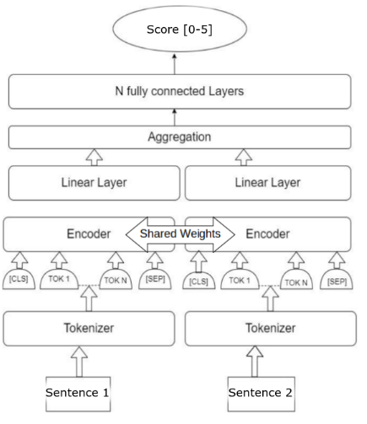
Siamese Model
Used Siamese architecture for a pair of sentences in generating encoding. A linear layer is then applied to the representation. These representations are then combined to create a single representation of the two sentences before being sent through fully connected layers to provide the similarity score, which ranges from 0 to 5.
If x₁ and x₂ are the encoding representation, then for aggregation step we used different strategies like x₁-x₂ and x₁+x₂ and other combinations, then passed to a next fully connected layer to compute the similarity score. We used MSE as a loss function.

Slide 9
Our Final Architecture – Using CNN
The model takes two input sentences and outputs a score indicating the semantic similarity between them.
The model consists of two parts:
Convolutional layer
Fully connected layers
The sentences are preprocessed and converted to vectors using GloVe 300d. Each sentence of a pair is passed into a 1-dimensional CNN layer. This layer helps to transfer GloVe word vectors to a more proper form for the task. The output is given to the pooling layer. The output from the pooling layer is flattened. Thus, we will get 2 flattened outputs corresponding to each sentence.
A semantic vector is generated by concatenating the element-wise absolute difference and the element-wise multiplication of the obtained embeddings of the 2 sentences.
The semantic vector is passed to a FCNN which has 2 layers. The second layer combined with a softmax activation function produced the similarity label probability distribution. The FCNN was trained without using regularization or dropout.
Loss function is designed to backpropagate the negative of PCC obtained from predicted similarity score and true similarity score.

Slide 10
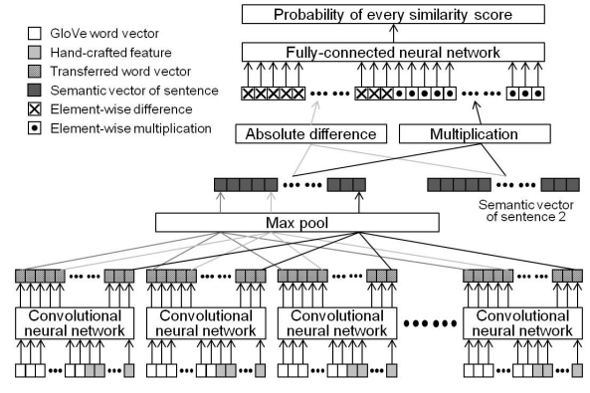
CNN Model Architecture

Slide 11
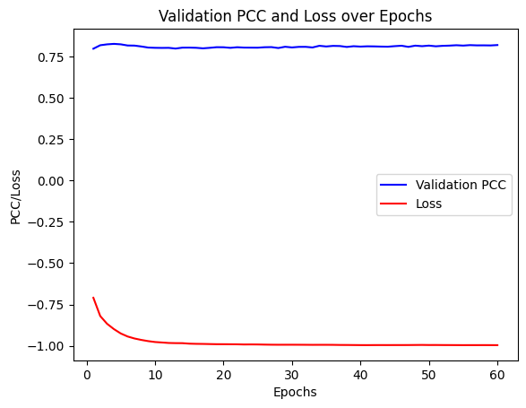
Hyper parameters
The following hyperparameters were considered for tuning:
Learning rate of optimizer
Kernel size of convolutional layer
Number of filters in convolutional layer
Number of units in dense layer
Batch size
Optimal hyperparameters were selected based on the lowest validation loss.

Slide 12
Example
 | S. No. | Sentence 1 | Sentence 2 | Gold Standard | STS Predicted
English - English | 1 | There are dogs in the forest. | The dogs are alone in the forest. | 4.0 | 3.7
 | 2 | A person is on a baseball team | A person is playing basketball on a team. | 2.4 | 2.7
Spanish-Spanish | 1 | Personas teniendo una barbacoa | La gente está en casa cenando. | 1.4 | 1.6
 | 2 | Un hombre camina en la ciudad. | Una mujer camina en la ciudad. | 2.4 | 2.4

Slide 13

Results
The proposed model achieved great results on the English and Spanish datasets for semantic textual similarity, with PCC scores of 0.806 and 0.771, respectively.
The proposed model outperformed base models using pre-trained BERT and Bag of Words approaches, with cosine similarity scores of 0.343 and 0.627, respectively.
The proposed model also outperformed another model that used only fully connected neural network on pre-trained sentence embeddings, achieving a PCC score of 0.168, which is significantly lower.
These results strongly suggest that the proposed model effectively captures the semantic similarity between sentences and outperforms other approaches in this task.

Slide 14
THANK YOU

